Slide 1
Sankey Diagrams Also known as: Sankey bar chart, alluvial diagram
Jessica Lavery
Open Study Group
December 17, 2019

Slide 2
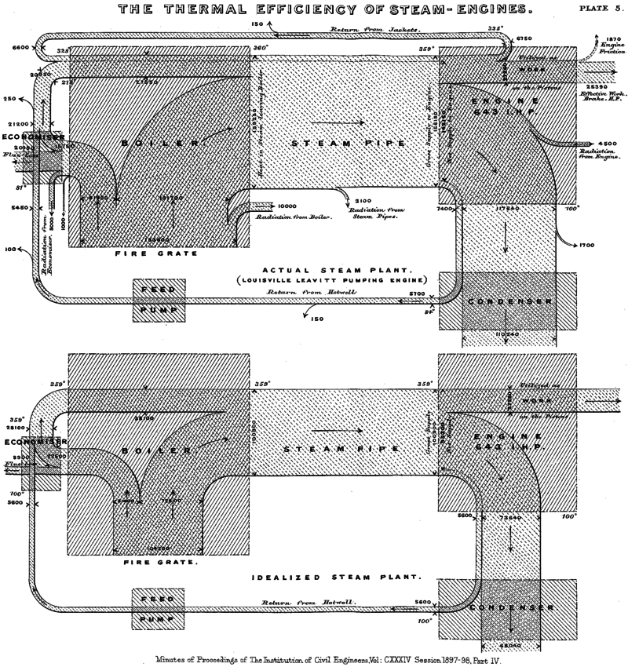
Introduction to Sankey Diagrams
What is it? A type of flow diagram
Background: Named after the first person to publish this type of diagram to visualize energy efficiency of a steam engine
The first Sankey (1898)

Slide 3
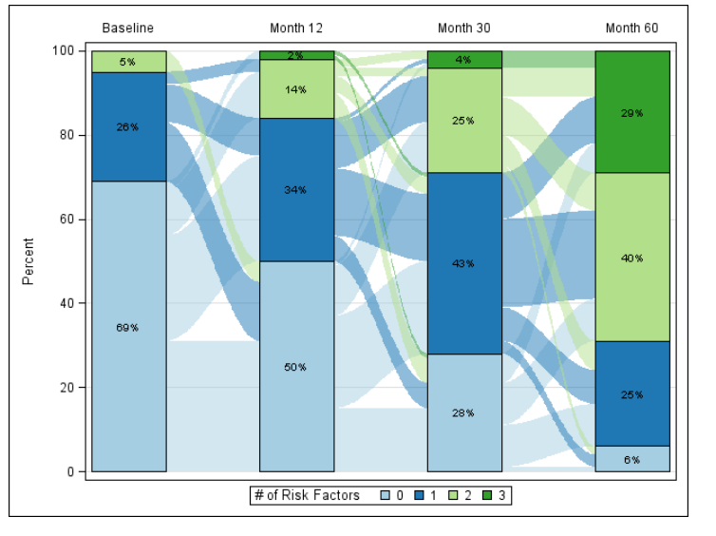
Example & Interpretation
Each bar corresponds to a different time point and indicates the distribution of the number of risk factors
At baseline: 69% of patients had 0 risk factors; 26% had 1 and 5% had 2
The flow between the bars indicates the change in risk factor status over time
Of the patients with 0 risk factors at baseline, approximately half also had 0 risk factors at month 12, the remaining had 1 or more risk factors
Example: Risk factors over time

Slide 4
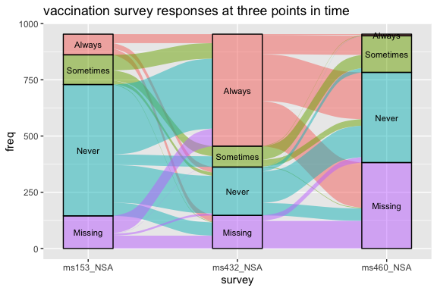
Applications
Changes over time (previous example)
Survey data (right)
In general: Generally trying to visualize two proportions (the proportion in the stacked bar and the proportion that change at the next bar)

Slide 5
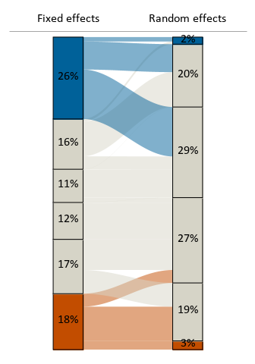

Examples from prior work: Hospital ranking of low-volume providers based on two different statistical approaches
Background:
Ranked all providers into quintiles
Subset on low volume providers to assess how their ranking changed across methods
Interpretation:
26% of low volume providers were ranked in the top quintile using the fixed effects method, while only 2% of low volume providers were ranked in the top quintile using the random effects method.
Few providers moved from the middle quintiles to the extremes, though there was substantial movement from the extremes (FE) to the middle (RE).

Slide 6
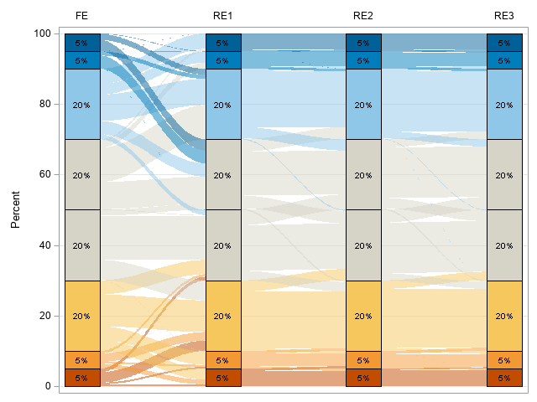
Expanded version from the same project
Now looking at top and bottom 5%, 10% and middle quintiles

Slide 7

SAS Code
%rawtosankey(): to prep dataset for Sankey macro
%sankeybarchart(): Produces the Sankey bar chart via PROC SGPLOT
Paper includes examples using dummy dataset
https://www.pharmasug.org/proceedings/2015/DV/PharmaSUG-2015-DV07.pdf

Slide 8
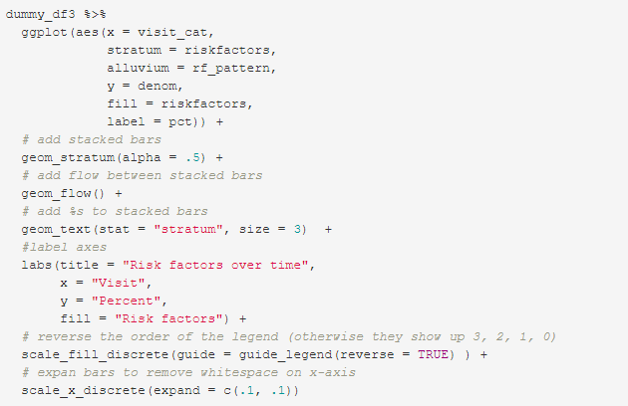
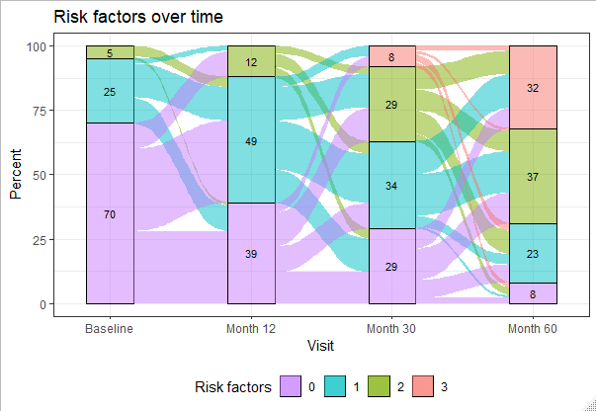
R Code
ggalluvial package (CRAN)
Not officially part of tidyverse but adheres to tidyverse principles
Vignette available
R code provided to create same diagram as in SAS for ease of comparison (RMarkdown file)

Slide 9
Sankey diagrams in the wild

Slide 10
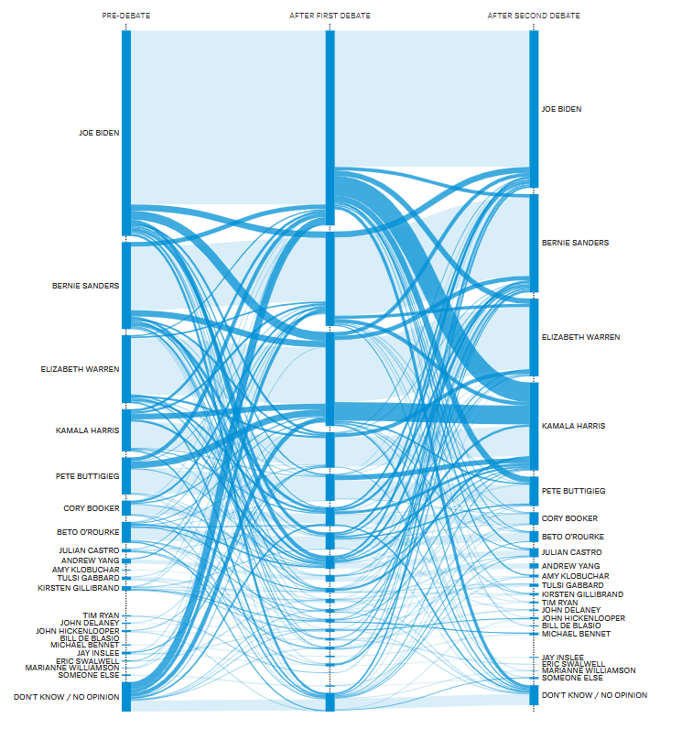
FiveThirtyEight: Who’s changing voters’ minds?
Notes:
https://projects.fivethirtyeight.com/democratic-debate-poll/

Slide 11
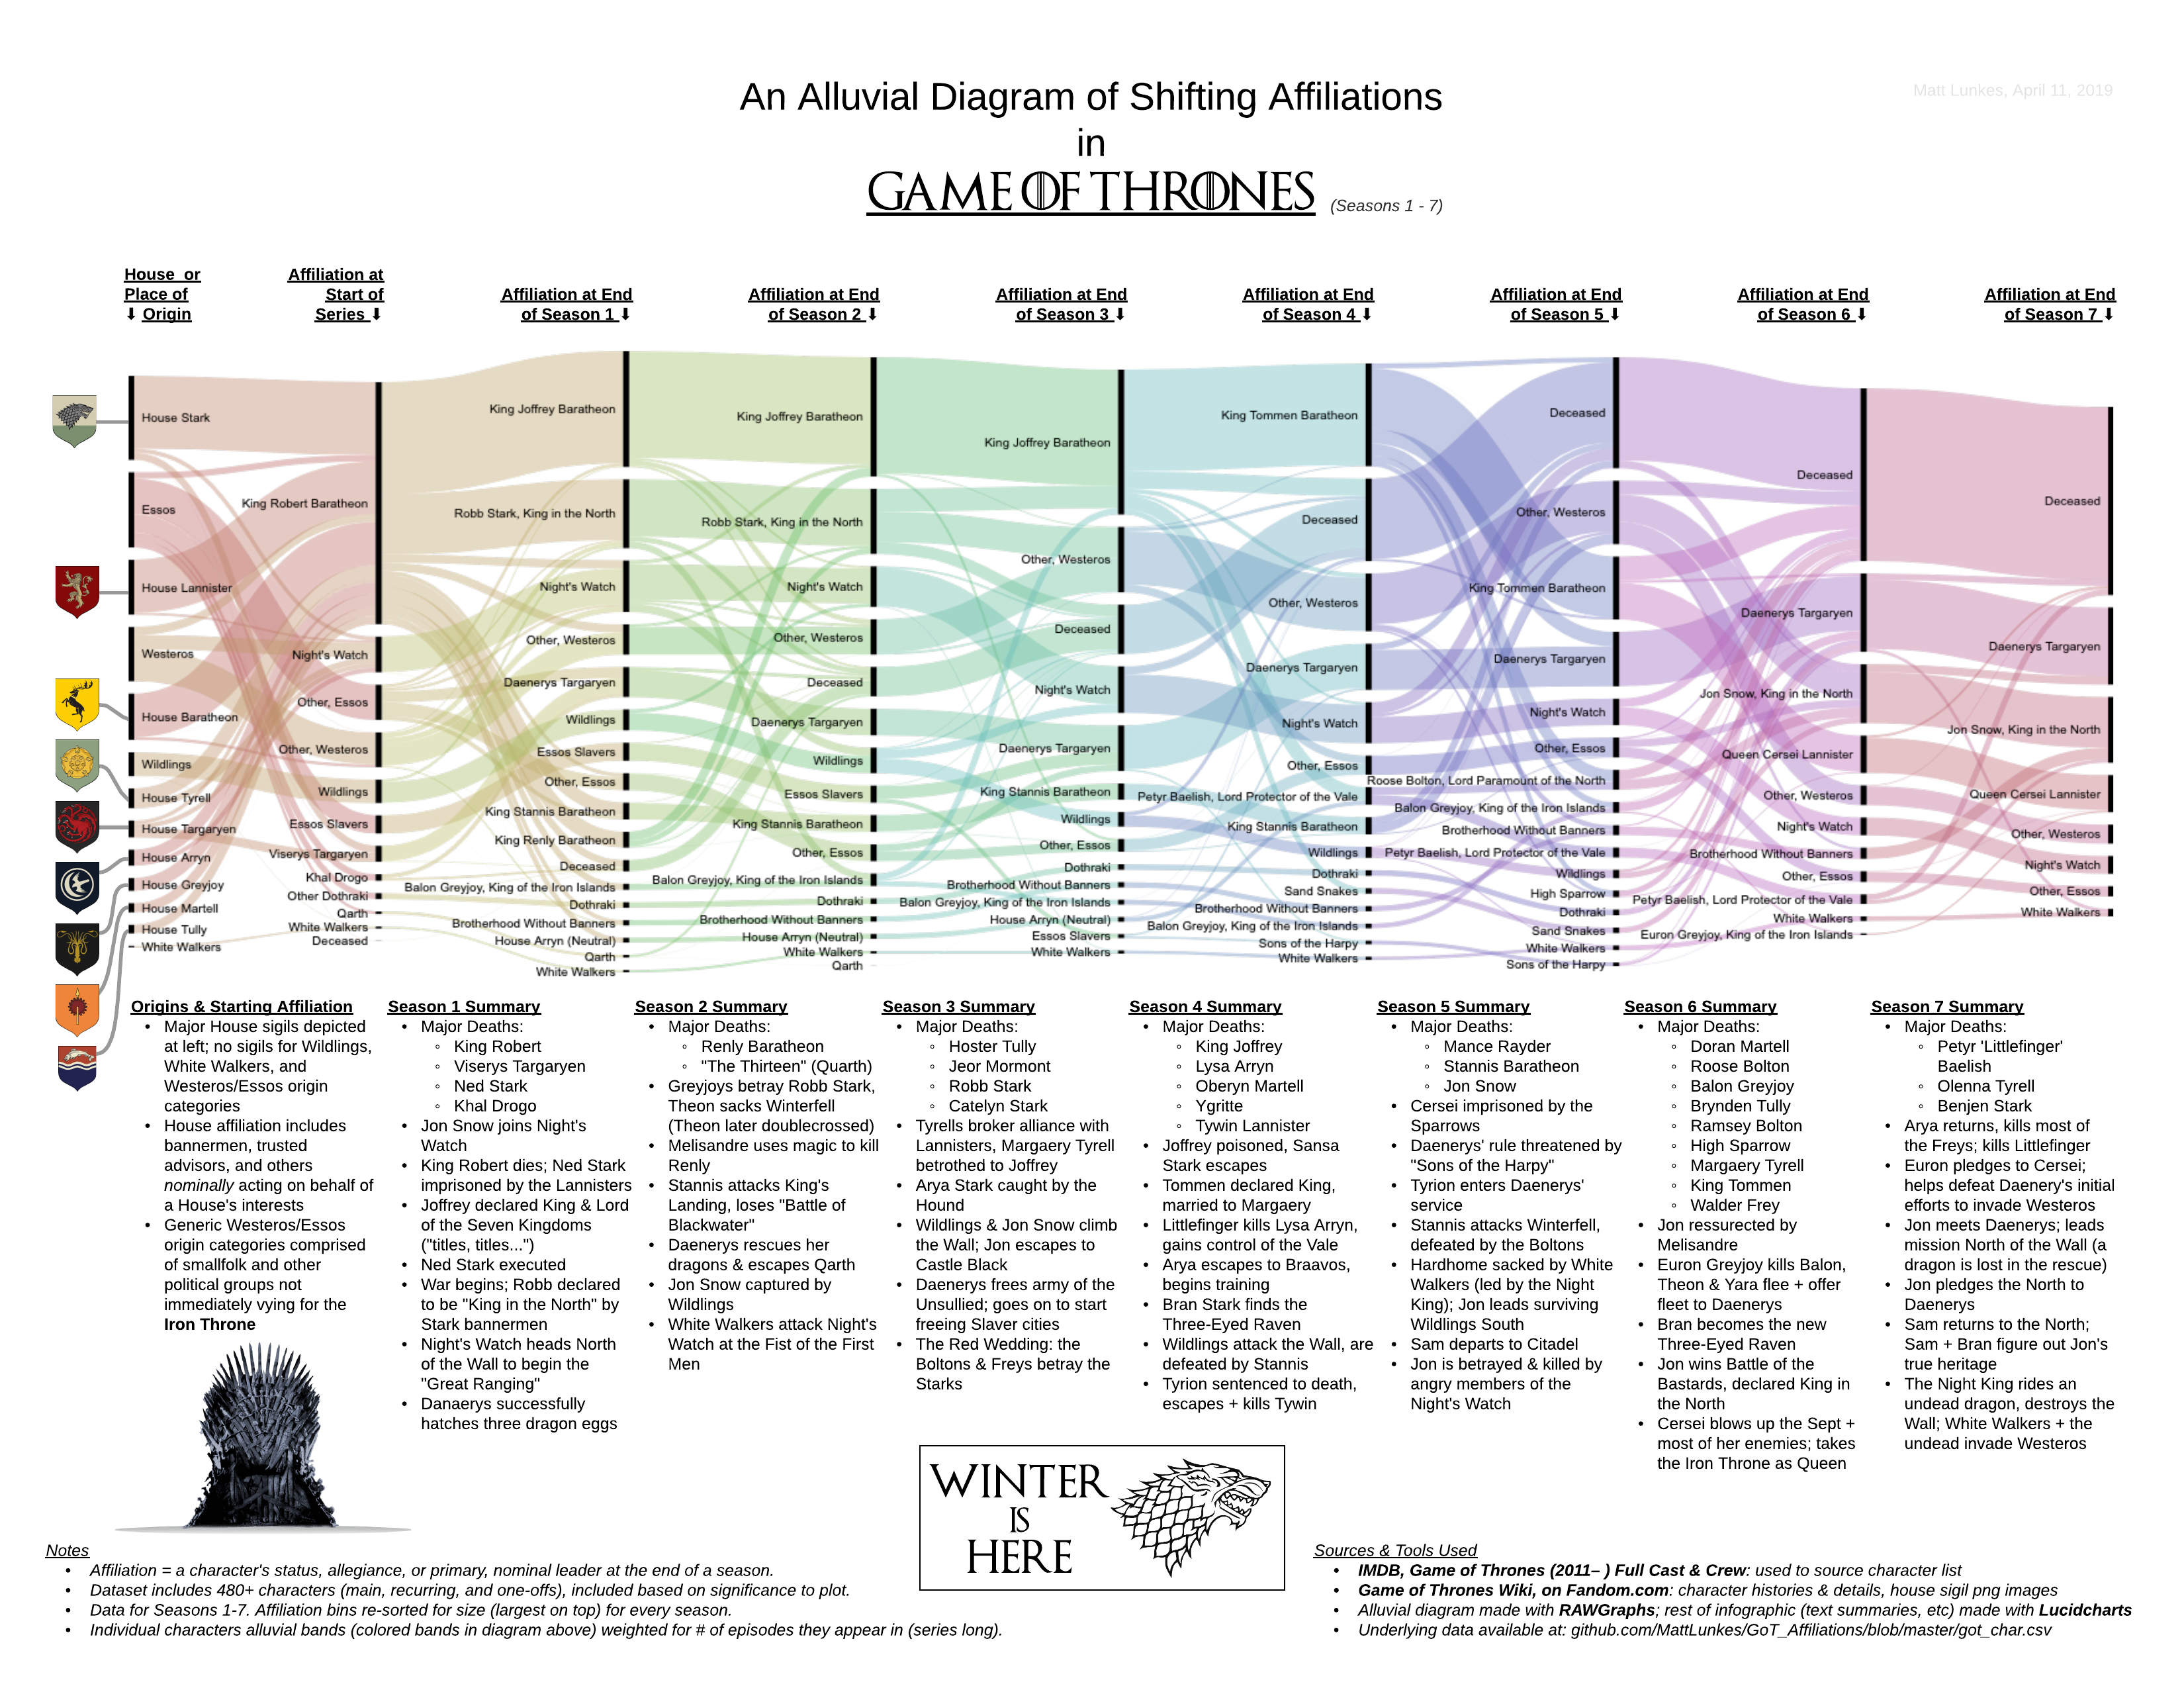
Notes:
https://medium.com/@matthewlunkes/a-game-of-data-visualizations-243c3d8ceb1e

Slide 12
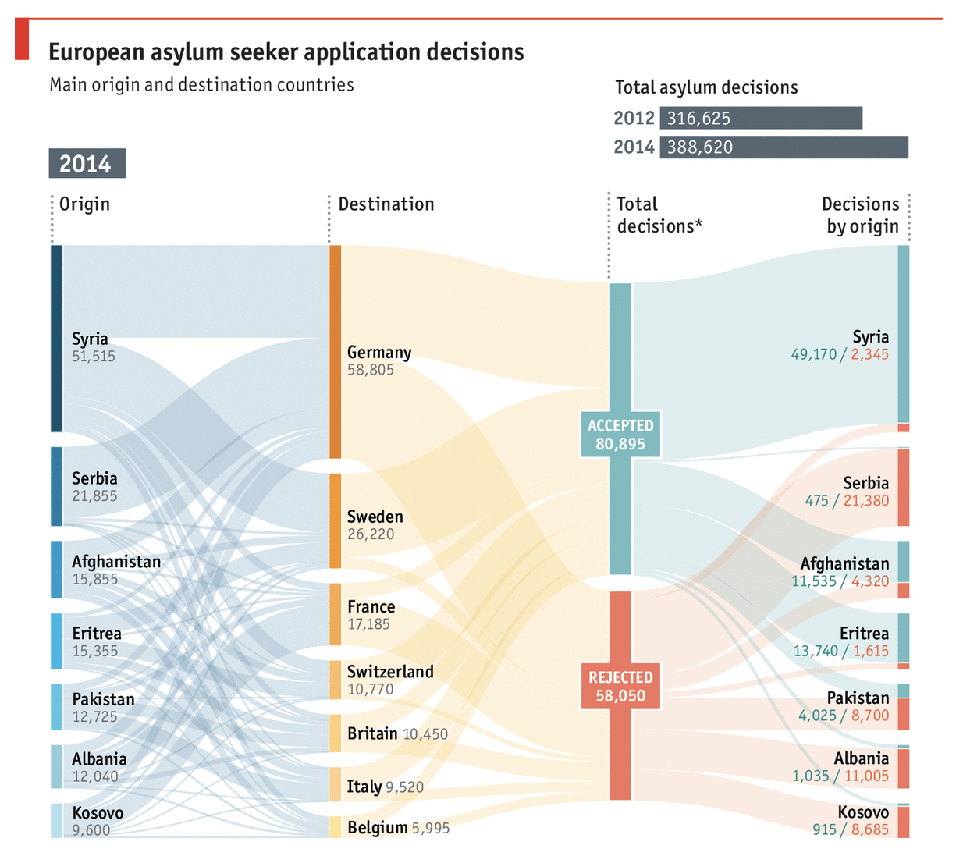
Notes:
https://datavizproject.com/data-type/alluvial-diagram/

